Slide 1

Intelligent Agents
Artificial Intelligence
School of Computing
Universiti Teknologi Malaysia

Slide 2
Outline
Agents and environments
Rationality
Intelligent agent - PAGE and PEAS
Agent types

Slide 3
Agents
An agent is an entity that perceives (observes) and acts
An agent is anything that can be viewed as perceiving its environment through sensors and acting upon that environment through actuators
Human agent:
  eyes, ears, and other organs for sensors;
  hands, legs, mouth, and other body parts for actuators
Robotic agent:
  cameras and infrared range finders for sensors;
  various motors for actuators

Slide 4
Percept refers to the agent’s perceptual input at a given instant
Percept Sequence is a complete history of percepts.

Slide 5
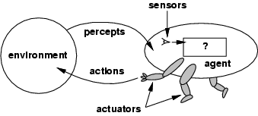
Agents and environments
The agent function maps from percept histories to actions:
[f: P* → A]
The agent program runs on the physical architecture to produce f
agent = architecture + program
Notes:
The agent function can be described as a huge table mapping percept sequence to actions.
This is an external description.
Internally it will usually be implemented by a function or program.
A good exmaple is the vac cleaner world

Slide 6
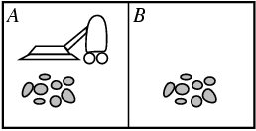
Vacuum-cleaner world
Percepts: location and contents, e.g., [A,Dirty]
Actions: Left, Right, Suck, NoOp
Notes:
Two cells only
Agent perceives: his location (Left, Right) + status of cell he is in (Dirty/ Not dirty)

Slide 7
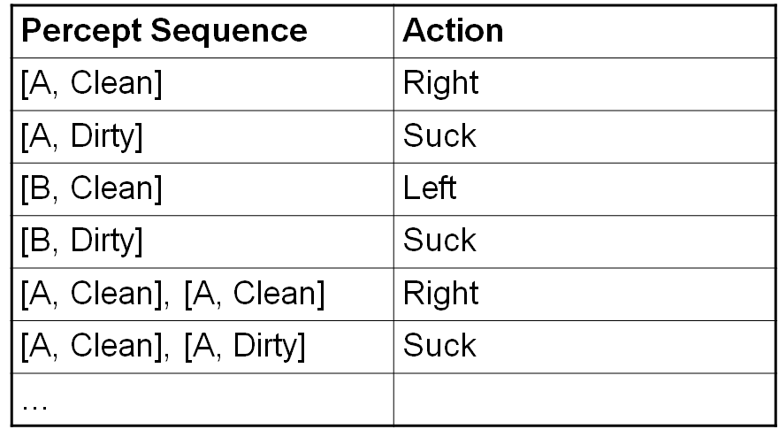
Vacuum-cleaner function
[location, status])
Notes:
Two cells only
Agent perceives: his location (Left, Right) + status of cell he is in (Dirty/ Not dirty)

Slide 8
The Vacuum-cleaner world
function REFLEX-VACUUM-AGENT ([location, status]) return an action
if status == Dirty then return Suck
else if location == A then return Right
else if location == B then return Left

Slide 9
Rational agents
A rational agent is one that acts in a manner that causes it to be as successful as it can.
What counts as successful obviously depends on what we require the agent to do.
We need to determine an appropriate performance measure in each case. One has to be careful in choosing that measure, as there are often many conflicting criteria that need to be taken into account.

Slide 10
Ideal Rational agents
An ideal rational agent is one that takes whatever action is expected to maximise its performance measure on the basis of the evidence provided by its perceptual history and whatever built-in knowledge it has
If an agent’s actions are based only on its built-in knowledge, and not on its own experience with its environment, then we say that the agent lacks autonomy.
An autonomous agent will supplement its built-in knowledge with its own acquired (or learned) knowledge in order to act appropriately.
It is often a good AI strategy to build systems/agents that have enough knowledge to get them started, and then leave them to learn the rest.
Notes:
:

Slide 11
Intelligent Agents - PAGE
Agents are comprised of an architecture (e.g. a computer) plus a program that runs on that architecture.
In designing intelligent systems there are four main factors to consider:
P Percepts – the inputs to our system
A Actions – the outputs of our system
G Goals – what the agent is expected to achieve
E Environment – what the agent is interacting with

Slide 12
Intelligent Agents - PEAS
PAGE Descriptors are not the unique way of describing intelligent systems.
One popular alternative involves PEAS Descriptors:
P Performance – how we measure the system’s achievement's
E Environment – what the agent is interacting with
A Actuators – what produces the outputs of the system
S Sensors – what provides the inputs to the system

Slide 13
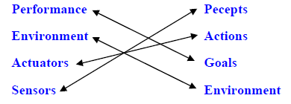
PAGE Descriptors vs. PEAS Descriptors
A simple mapping between PAGE and PEAS:

Slide 14
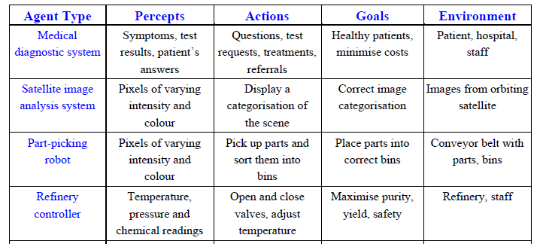
Examples of Intelligent Agents
Notes:
The example of the vac world was a bit simple.
What is the performance measure for the driver?
Environment?
Actuators?
Sensors?

Slide 15

Part-picking robot

Slide 16
Activity
Determine the PEAS for Interactive English Tutor

Slide 17

Answer for Activity

Slide 18
Agent types
We shall consider four types of agent system of increasing sophistication:
1. Simple Reflex Agents
2. Reflex Agents with an Internal State
3. Goal based agents
4. Utility based agents

Slide 19
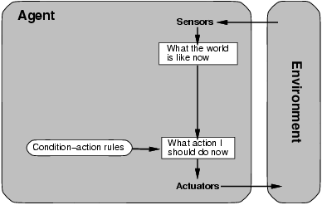
Simple reflex agents
Select action on the basis of only the current percept, e.g. the vacuum-agent
Implemented through condition-action rule, e.g.If dirty then suck
Notes:
Condition rule agent:
If car in front is breaking the action = break
Humans have many such reflex if then connections: some learned some reflexes.
Blinking when something come near the eye, retracting the hand from a hot plate
Driving bicycles (correctly maintaining balance)
The program above was specific to the vac cleaner agent: here is a general interpreter, to allow for a connection percept -> action
In this type of figures we use
rectangles for current initial state of the agents decision process
Ovals – background information used

Slide 20
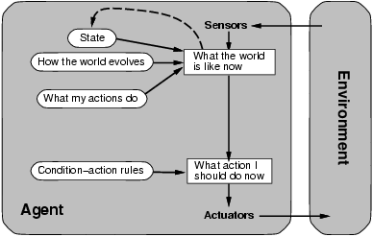
Model-based reflex agents
Able to keep track of its previous states (i.e. maintain a description or “model” of its previous history in the world),
Able to make better informed decisions about its actions.
Notes:
‘state’
The simplest way to take care of partial information is for the agent to keep track of the part of the world it cannot perceive NOW.
The agents needs to have some form of knowledge how the state changes by how the world evolves (independent of the agent) and by the agents actions. For example, if the agent put the keys in his pocket (and now does not see them) the model of state could contain this information.
‘state’ means that the agent will do different things with identical same percepts. For example with a taxi driver the state ‘ go home to rest’ or ‘at work’.
‘what the world is like now’
Clearly the ‘state’ and the current percept (by the sensors) do not produce a precise description of the environment. So ‘what the world is like now’ is a best guess of the agent

Slide 21
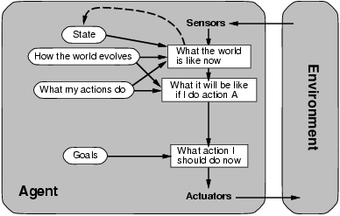
Goal-based agents
The appropriate action for the agent will often depend on what its goals are, and so it must be provided with some goal information.
If a long sequence of actions is required to reach the goal, then Search and Planning are the sub-fields of AI that must be called into action.
Notes:
Here decision is fundumentally different from that of the reflex agent which is based on condition-action rules.
It involves considering “what will happen if I take this action. So must have a model of the world, and a model of its action.
A reflex agent will brake when seeing break-lights.
A goal base agent will slow down in this situation, since the dynamics of the world is clear – this is the only way to avoid hitting other cars
This is a more flexible agent: when raining it may adapt its behavior to suit the new conditions.
For a reflex agent we will have to rewrite many condition-action rules…
The goal based agent can easily adapt to go to a different destination by simply specifying the new destination as the goal.
The reflex agent rules as to where to turn and whe to go straight will work for a single destination and must all be replaced if we want to go anywhere else.

Slide 22
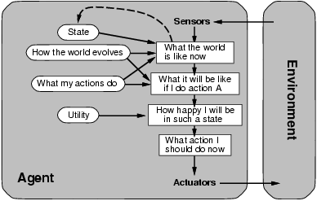
Utility-based agents
Described as possessing a utility function that maps a state, or sequence of states, on to a real number that represents its utility or usefulness.
Use the utility to choose between alternative sequences of actions/states that lead to a given goal being achieved.

Slide 23
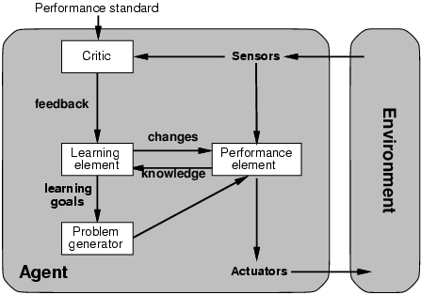
Learning agents
All previous four agent-programs describe methods for selecting actions.
Learning agents :
Modifies performance elements.
Teach them instead of instructing them.
Advantage is the robustness of the program toward initially unknown environments.

Slide 24
Learning agents
A general learning agent has four basic components:
The Performance Element – which takes in percepts and decides on appropriate actions in the same way as a non-learning agent.
The Critic – which uses a fixed standard of performance to tell the learning element how well the agent is doing.
The Learning Element – that receives information from the critic and makes appropriate improvements to the performance element.
The Problem Generator – that suggests actions that will lead to new and informative experiences (e.g. as in carrying out experiments).

Slide 25
Agent Environments
An agent perceives and acts in an environment, has an architecture, and is implemented by an agent program.
Often we run an environment program for our agents to interact with.
Five dimensions to categorize the properties of an agent’s environment : Accessible vs. Inaccessible, Deterministic vs. Non-deterministic, Discrete vs. Continuous, Episodic vs. Non-episodic, Static vs. Dynamic
The most challenging environments are inaccessible, non-deterministic, continuous, non-episodic, and dynamic.

Slide 26
Accessible vs. Inaccessible
An environment is accessible to an agent if the agent’s sensory apparatus gives it access to the complete state of the environment.
Thus, the agent will not then need to maintain an internal state to keep track of the world.

Slide 27
Deterministic vs. Non-deterministic
The environment is deterministic if its next state is determined completely by its current state and the actions of its agents. A deterministic but inaccessible environment may appear non-deterministic to the agent.
Most real environments are so complex that, in practice, they have to be treated as non-deterministic.

Slide 28
Discrete vs. Continuous
A discrete environment has a limited/finite number of distinct, clearly defined percepts and actions.

Slide 29
Episodic vs. Non-episodic
In an episodic environment the agent’s experience can be divided into “episodes” consisting of the agent perceiving and then producing actions that depend only on that episode.
Non-episodic (subsequent episodes) do not depend on previous episodes, and so the agent can limit how far it needs to think ahead.

Slide 30
Static vs. Dynamic
A static environment does not change while an agent is deliberating. The agent will then have no need to keep checking the world while it is deciding on an action, nor worry about the passage of time.

Slide 31
Components of an AI Agent
We now have a good idea of the components that need to be built into an AI agent:
A means to infer properties of the world from its percepts.
Information about the way the world evolves.
Information about what will happen as a result of its possible actions.
Utility information indicating the desirability of possible world states and the actions that lead to them.
Goals that describe the classes of states whose achievement maximises the agent’s utility.
A mapping from the above forms of knowledge to its actions.
An active learning system that will improve the agents ability to perform well.

Slide 32
Summary: Intelligent Agents
An agent perceives and acts in an environment, has an architecture, and is implemented by an agent program.
An ideal rational agent always chooses the action which maximizes its expected performance, given its percept sequence.
Task environment – PAGE (Percepts, Actions, Goals, Environment) and PEAS (Performance, Environment, Actuators, Sensors)

Slide 33
Summary: Intelligent Agents
An agent program maps from percept history to action and updates internal state.
Agents can improve their performance through learning.
The most challenging agent environments are inaccessible, nondeterministic, dynamic, and continuous.

